Slide 1

Festival Food Finder – Discover Trending Foods
EMPOWERING STREET FOOD VENDORS THROUGH TECHNOLOGY
BY: THE INNOVATORS
1

Slide 2
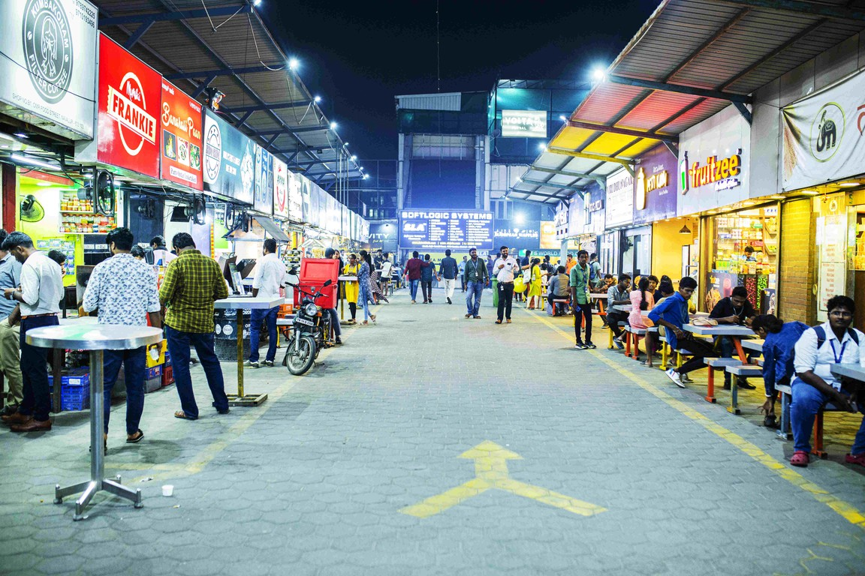


PROBLEM STATEMENT
Street food vendors struggle with low visibility and limited customer reach. Customers often miss out on discovering trending or popular local foods nearby.
No unified digital platform exists to connect vendors with customers effectively. Vendors rely mostly on foot traffic or word of mouth, limiting their business growth.
The absence of data insights and online presence reduces vendors’ competitiveness.

Slide 3


OUR SOLUTION
We propose a web-based platform that connects street food vendors with nearby customers.
The we shows trending food items based on location and customer interest.
Vendors can easily update their menu, offers, and stall location through a simple dashboard.
Customers can explore popular stalls, read reviews, and get directions in real-time.
This solution gives vendors greater visibility, and customers a more engaging food experience.

Slide 4


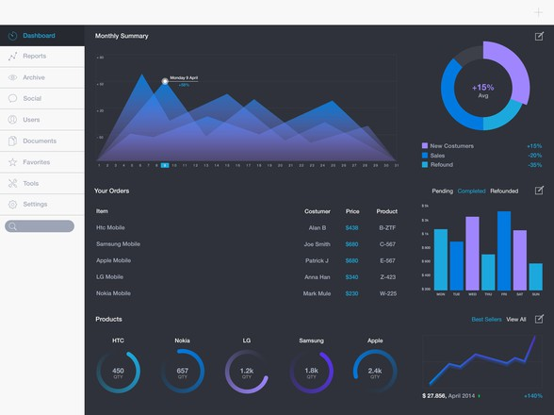




FEATURES
🔥 Trending food highlights
📍 Location-based food discovery
👨‍🍳 Vendor dashboard to manage items
Series 1
Series 2
Series 3
50
🌟 Rating G review system
40
30
20
10
📊 Analytics for vendors
0
Item 1
Item 2
Item 3
Item 4
Item 5

Slide 5

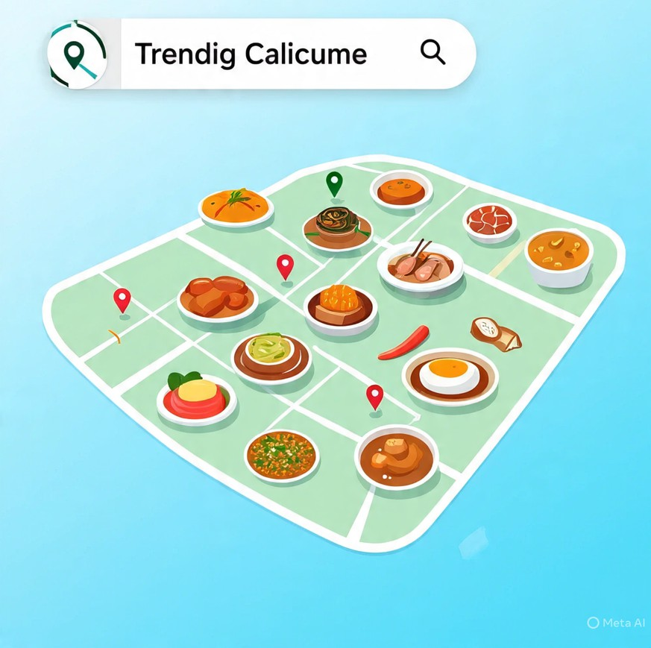


🎯 REAL-LIFE IMPACT
🧑‍🍳 Empowering Local Vendors
🧭 Better Food Discovery for Users
📶 Digital Footprint for Unorganized Sector
📈 Data-Driven Decisions
🌍 Community Engagement
Promotes local food culture, supports small businesses, and enhances the city’s street food ecosystem.
🔭 FUTURE SCOPE
💳 Digital Payments Integration
🎁 Loyalty G Reward Programs
🛒 Pre-order G Pick-up Options
📲 Mobile App Version
🧾 Vendor Onboarding via WhatsApp
🛰 AI-based Recommendation System

